Slide 1
Amazon Business Approver Training
Name
Date

Slide 2
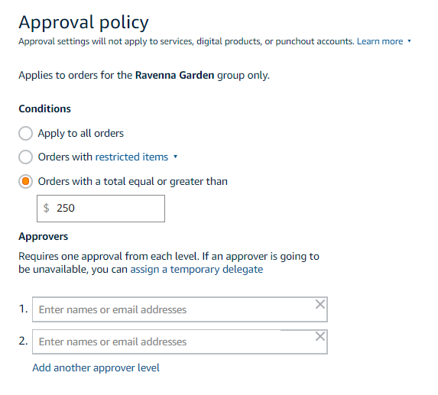
Approval Policies
Approval workflows provide visibility and control over purchasing
Each level of approval can have more than one approver. Only one approval is needed at each level.
Approvers are notified of pending orders through email as well as when they log into their Amazon Business account.
Only active account users can be configured as approvers.

Slide 3
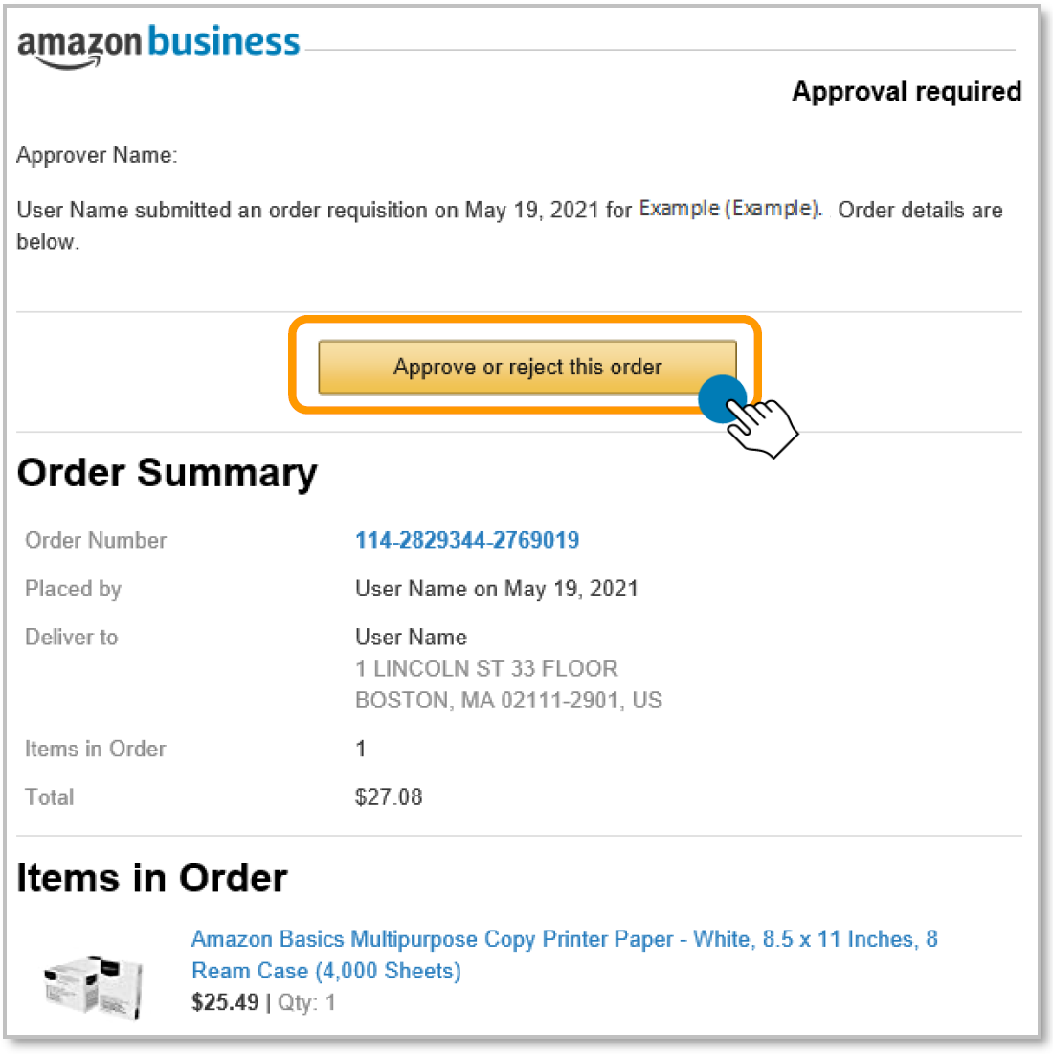
Approving Orders
When a user places an order with an approval policy required, the approver will get an email notifying them of the request.
Once a purchase is submitted for approval, the order is held for 7 days. Approval requests that take longer than 7 days will be rejected
Purchase requests can be approved directly from the email or by navigating to Approve Orders in the top right drop down of your account.

Slide 4
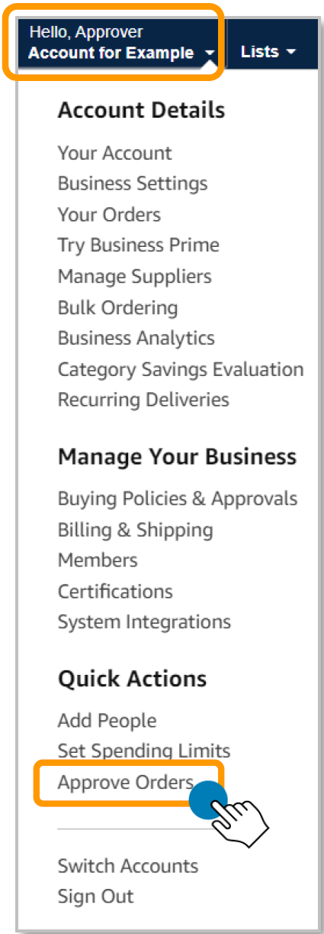
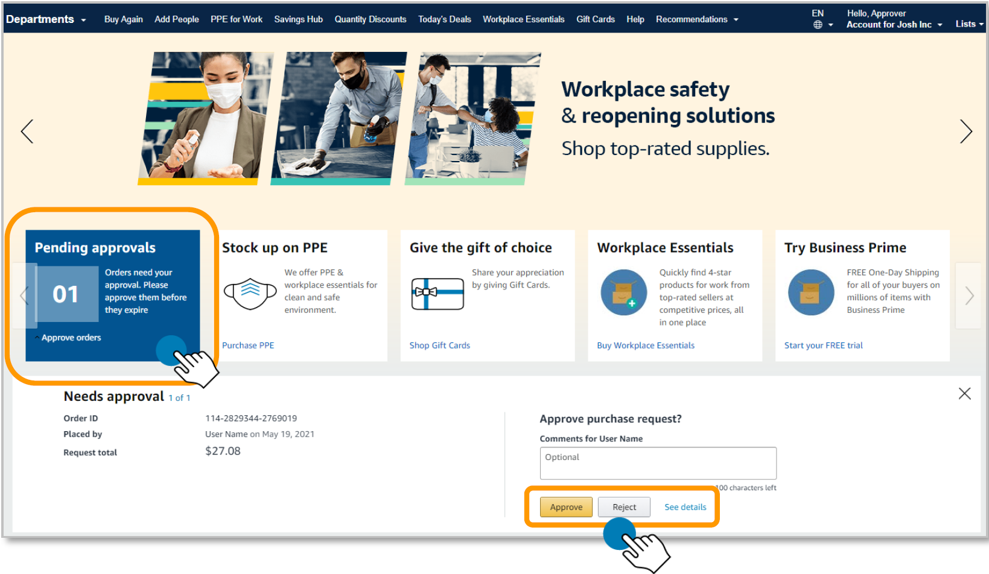
Approving Orders
Purchase requests can be approved directly from the email (edit if SSO) or by navigating to Approve Orders in the top right drop down of your account.

Slide 5
Purchase requests page
The Purchase requests page allows you to review orders that have been submitted for approval.
You can select the check box on the left hand side of the order and Approve selected or Reject selected order(s) from this page.
If you wish to review the order in further detail, you can select Needs Review.
If you have multiple orders awaiting approval, you have the option to approve or reject them in bulk

Slide 6
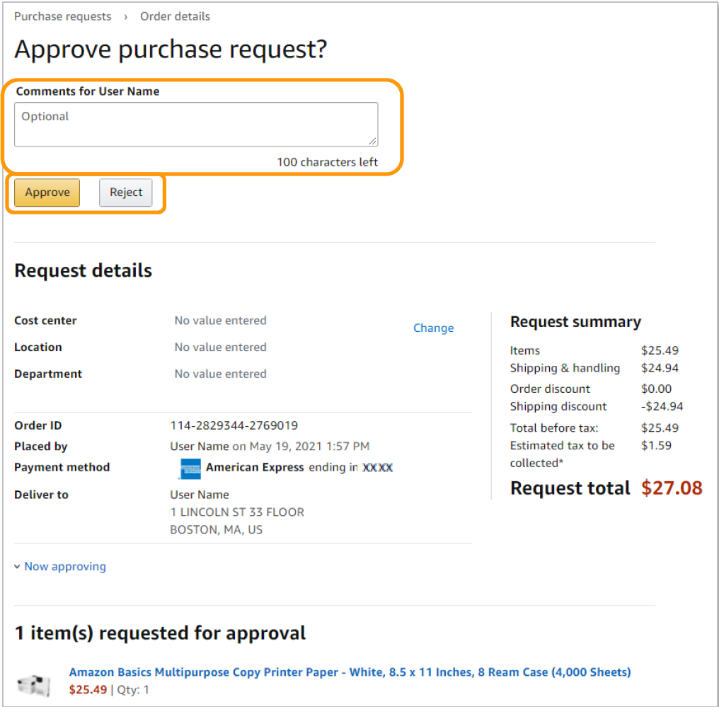
Approve/Reject
Review order details and Approve or Reject the order. You are also able to include comments on the reasoning for order approval or rejection for the user to review.

Slide 7
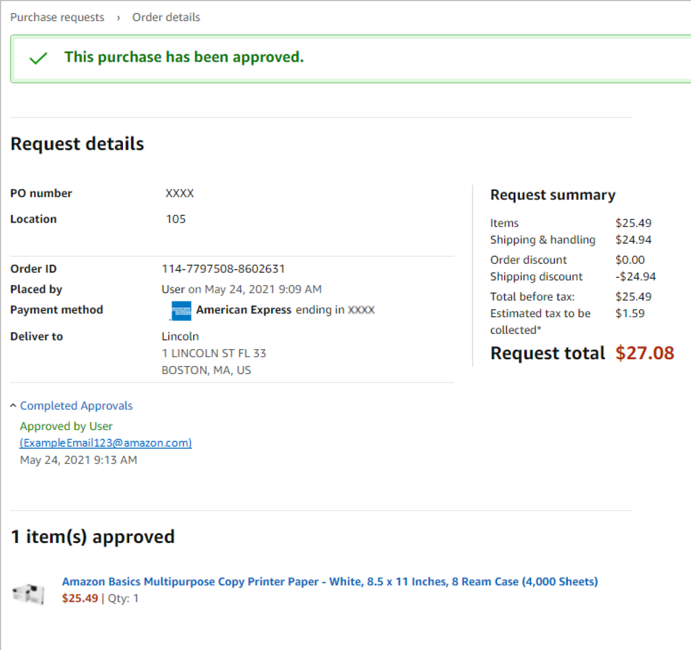
Email Confirmation
Once an order is approved or rejected, you will receive a confirmation and the order requestor will also be notified via email.

Slide 8
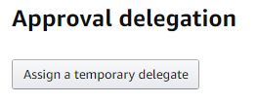
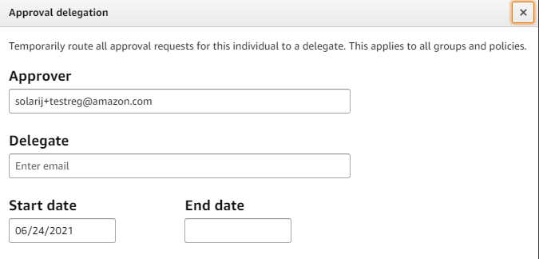
Assign an Approval Delegate
An approver can assign an approval delegate for time periods where that primary approver will be out of the office or unable to approve orders.
Navigate to your approval queue by selecting Approve Orders from the drop down menu in the top right hand corner of your homepage.
Click Assign a temporary delegate.
Enter approval delegate’s email address and the start and end date for the approval delegation to be applied and save.

Slide 9
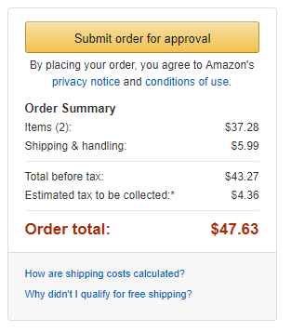
Approval Workflow – User Experience
All orders placed on the account are subject to approval before being fulfilled
How do I order with Approvals configured?
There are no additional steps to take to submit your order for approval. Check out as you normally would and you will see the option at checkout. As an approver, you will not have to approve your own orders despite selecting Submit order for approval at checkout.
Your order will not be processed until it is approved by the appropriate approver. Keep this in mind for shipping timelines. You will be notified over email once your order is submitted and then again once your order has been approved and processed. Just as with a normal order on Amazon, you will also receive relevant shipping updates.
If your order is not approved within 7 days, the order will automatically be canceled; however, the items in your order will not be deleted. If your order is canceled, you will need to submit the order again for approval.

Slide 10
Business Customer Support

Slide 11
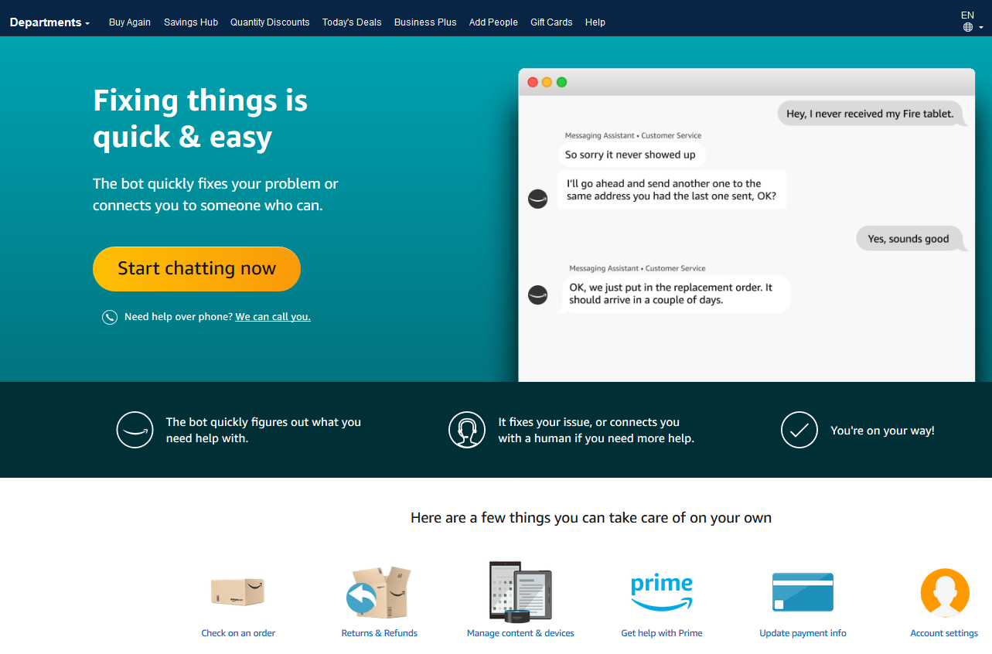
Business Customer Support
Dedicated U.S. based Business Customer Support can be reached a number of ways including email, chat and phone. Not sure what you’re looking for? Learn more about the features and benefits on Amazon Business HERE.

